Slide 1
SCS1302 Internet Programming
Unit 2 JavaScript
Ms.J.S.Vimali

Slide 2
Numeric Sort
By default, the sort() function sorts values as strings.
This works well for strings ("Apple" comes before "Banana").
However, if numbers are sorted as strings, "25" is bigger than "100", because "2" is bigger than "1".
Because of this, the sort() method will produce incorrect result when sorting numbers.
You can fix this by providing a compare function:
Example
var points = [40, 100, 1, 5, 25, 10];
points.sort(function(a, b){return a - b});
Use the same trick to sort an array descending:
var points = [40, 100, 1, 5, 25, 10];
points.sort(function(a, b){return b - a});

Slide 3
The Compare Function
The purpose of the compare function is to define an alternative sort order.
The compare function should return a negative, zero, or positive value, depending on the arguments:
function(a, b){return a - b}
When the sort() function compares two values, it sends the values to the compare function, and sorts the values according to the returned (negative, zero, positive) value.
If the result is negative a is sorted before b.
If the result is positive b is sorted before a.
If the result is 0 no changes are done with the sort order of the two values.
Example
The compare function compares all the values in the array, two values at a time (a, b).
When comparing 40 and 100, the sort() method calls the compare function(40, 100).
The function calculates 40 - 100 (a - b), and since the result is negative (-60), the sort function will sort 40 as a value lower than 100.
You can use this code snippet to experiment with numerically and alphabetically sorting:

Slide 4
<!DOCTYPE html>
<html>
<body>
<h2>JavaScript Array Sort</h2>
<p>Click the buttons to sort the array alphabetically or numerically.</p>
<button onclick="myFunction1()">Sort Alphabetically</button>
<button onclick="myFunction2()">Sort Numerically</button>
<p id="demo"></p>
<script> var points = [40, 100, 1, 5, 25, 10]; document.getElementById("demo").innerHTML = points; function myFunction1() { points.sort(); document.getElementById("demo").innerHTML = points;} function myFunction2() { points.sort(function(a, b){return a - b}); document.getElementById("demo").innerHTML = points;}
</script></body></html>

Slide 5
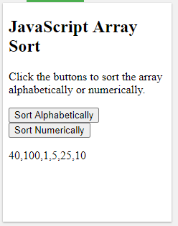



Slide 6
Different Kinds of Loops
JavaScript supports different kinds of loops:
for - loops through a block of code a number of times
for/in - loops through the properties of an object
for/of - loops through the values of an iterable object
while - loops through a block of code while a specified condition is true
do/while - also loops through a block of code while a specified condition is true
The For Loop
The for loop has the following syntax:
for (statement 1; statement 2; statement 3) {
// code block to be executed
}

Slide 7
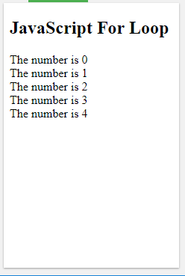
<!DOCTYPE html>
<html>
<body>
<h2>JavaScript For Loop</h2>
<p id="demo"></p>
<script>
var text = "";
var i;
for (i = 0; i < 5; i++) {
text += "The number is " + i + "<br>";
}
document.getElementById("demo").innerHTML = text;
</script>
</body>
</html>

Slide 8
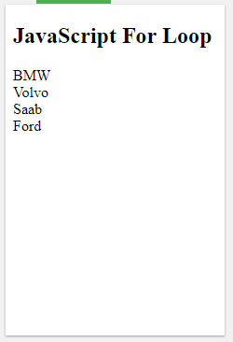
<!DOCTYPE html>
<html>
<body>
<h2>JavaScript For Loop</h2>
<p id="demo"></p>
<script>
var cars = ["BMW", "Volvo", "Saab", "Ford"];
var i, len, text;
for (i = 0, len = cars.length, text = ""; i < len; i++) {
text += cars[i] + "<br>";
}
document.getElementById("demo").innerHTML = text;
</script>
</body>
</html>

Slide 9
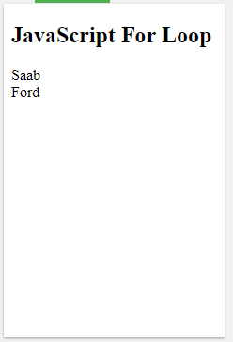
<!DOCTYPE html>
<html>
<body>
<h2>JavaScript For Loop</h2>
<p id="demo"></p>
<script>
var cars = ["BMW", "Volvo", "Saab", "Ford"];
var i = 2;
var len = cars.length;
var text = "";
for (; i < len; i++) {
text += cars[i] + "<br>";
}
document.getElementById("demo").innerHTML = text;
</script>
</body>
</html>

Slide 10
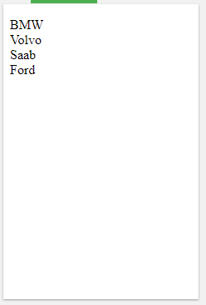
<!DOCTYPE html>
<html>
<body>
<p id="demo"></p>
<script>
var cars = ["BMW", "Volvo", "Saab", "Ford"];
var i = 0;
var len = cars.length;
var text = "";
for (; i < len; ) {
text += cars[i] + "<br>";
i++;
}
document.getElementById("demo").innerHTML = text;
</script>
</body>
</html>

Slide 11
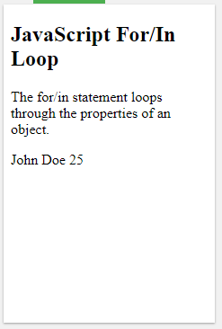
The For/In Loop
The JavaScript for/in statement loops through the properties of an object:
<!DOCTYPE html>
<html><body>
<h2>JavaScript For/In Loop</h2>
<p>The for/in statement loops through the properties of an object.</p>
<p id="demo"></p>
<script>
var txt = "";
var person = {fname:"John", lname:"Doe", age:25};
var x;
for (x in person) {
txt += person[x] + " ";
}
document.getElementById("demo").innerHTML = txt;
</script></body></html>

Slide 12
The For/Of Loop
The JavaScript for/of statement loops through the values of an iterable objects
for/of lets you loop over data structures that are iterable such as Arrays, Strings, Maps, NodeLists, and more.
The for/of loop has the following syntax:
for (variable of iterable) {
// code block to be executed
}

